Slide 1
Foreign Direct Investment Analytics

Slide 2
Problem Statement:
Investment is a game of understanding historic data of investment objects under different events, but it is still a game of chances. To minimize risk, we apply analytics to find the equilibrium in investment.
Specifically, this project aims to understand Foreign Direct Investment (FDI) in India over the last 17 years, from 2000-01 to 2016-17. The dataset contains sector and financial year-wise data of FDI in India. The goals are to:
- Conduct sector-wise investment analysis.
- Perform year-wise investment analysis.
- Identify key metrics and factors.
- Show meaningful relationships between different attributes in the dataset.
- Conduct research to uncover findings that can guide investment decisions and policy-making.

Slide 3
Objective of the Project
- Understand the Trends:
- Examine yearly trends in FDI to identify periods of significant growth or decline.
- Determine how investments have evolved over time and identify any patterns or anomalies.
- Sector-Wise Analysis:
- Analyze FDI distribution across different sectors to identify which sectors have attracted the most investment.
- Understand the sectoral preferences of foreign investors and highlight key sectors driving FDI.
- Identify Key Metrics:
- Calculate and interpret key metrics such as total investments, yearly growth rates, and sector-wise contributions.
- Identify meaningful relationships between different attributes in the dataset.
- Business Problems and Solutions:
- Address business problems such as diversification of investments across sectors and identification

Slide 4
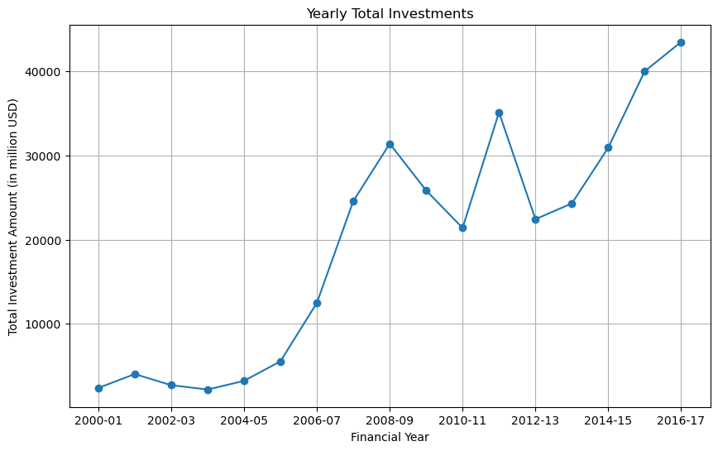
Line Plot of Yearly Total Investments

Slide 5
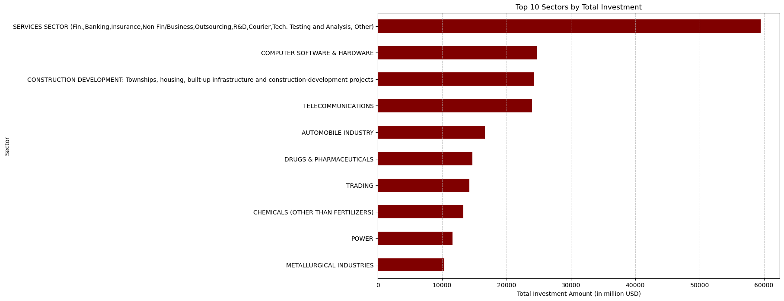
Top 10 Sectors by Total Investment

Slide 6
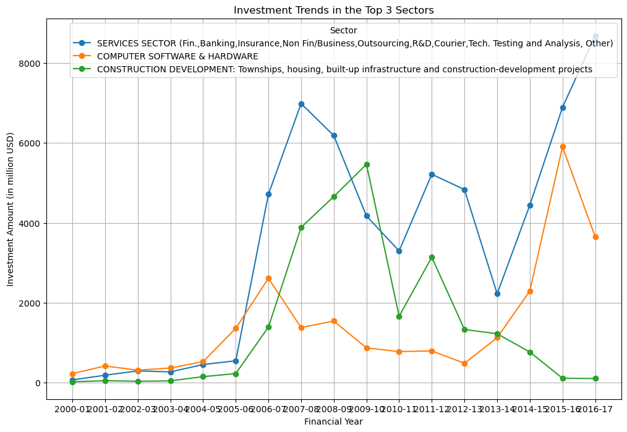
Investment Trends in the Top 3 Sectors

Slide 7
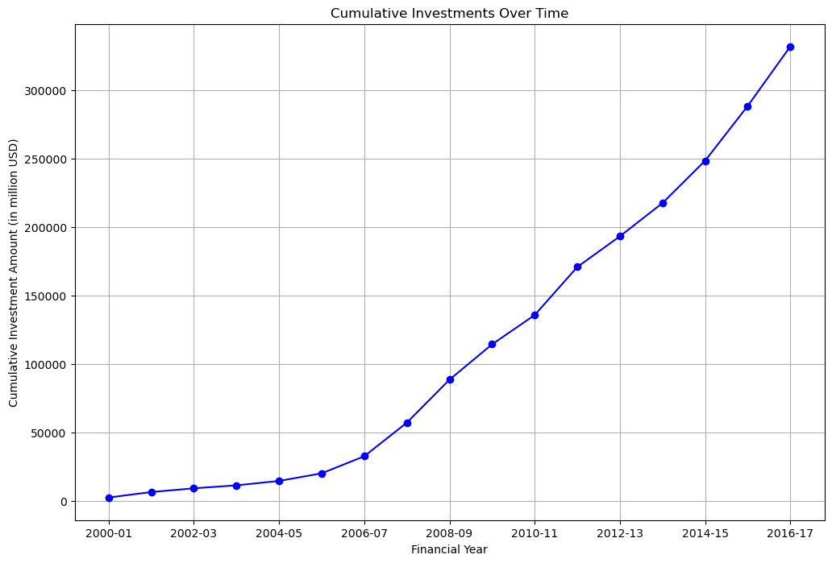
Cumulative Investments Over Time

Slide 8
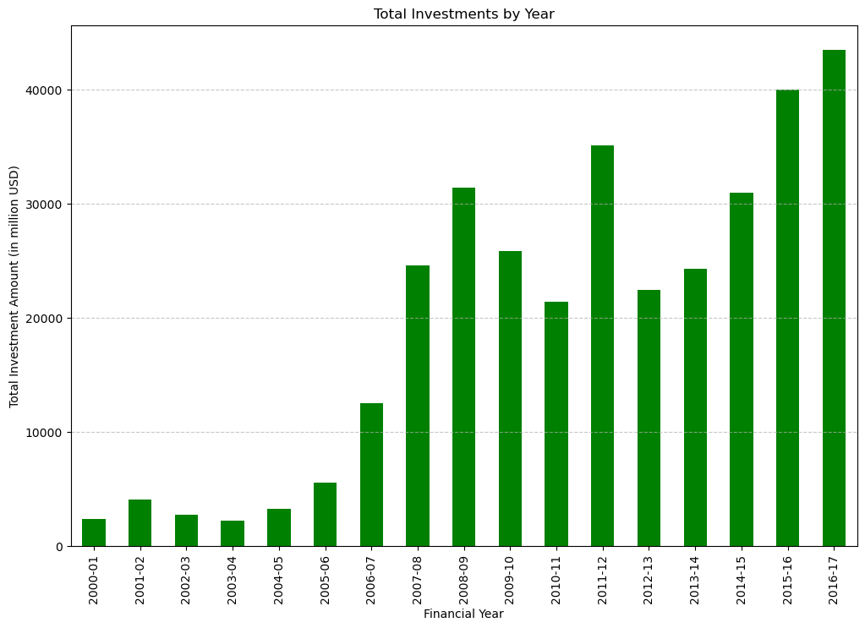
Year with the Most Investment

Slide 9
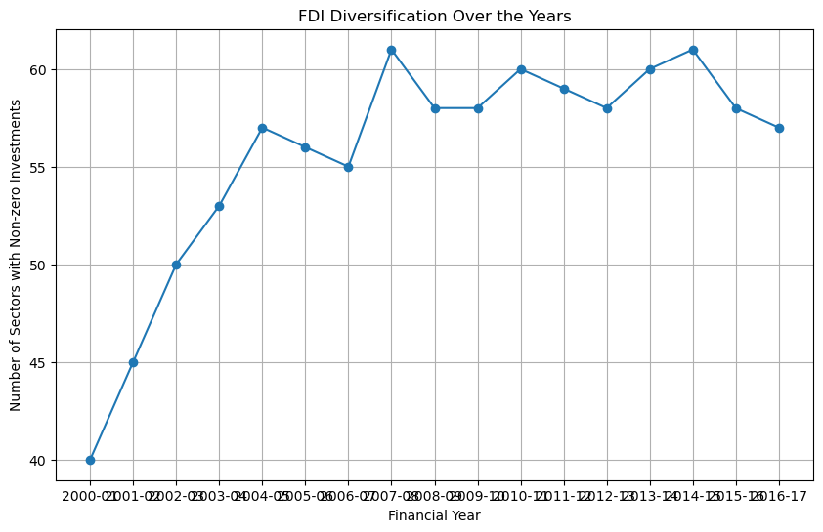
Business Problem
Investment Diversification Analysis
How diversified are FDI investments across different sectors, and has this diversification changed over time?

Slide 10
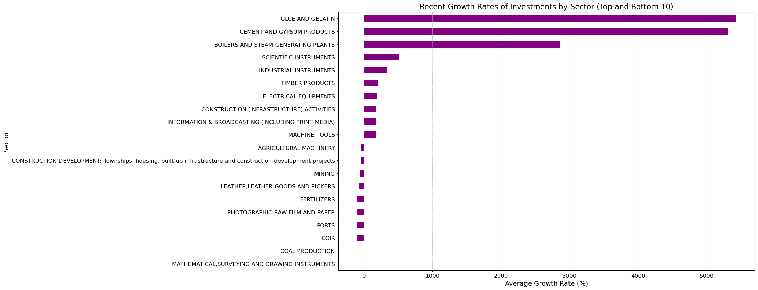
Identification of Emerging Sectors Which sectors have shown recent significant increases in FDI, indicating emerging investment trends?

Slide 11
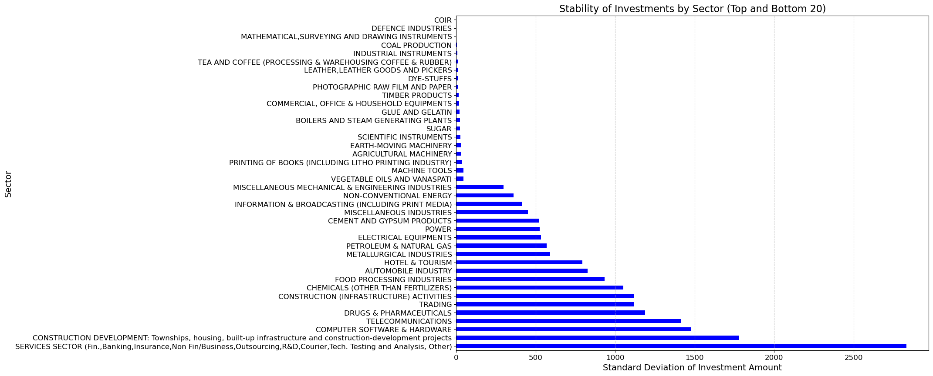
Investment Stability Analysis Which sectors have the most stable FDI inflows, and which are the most volatile?

Slide 12
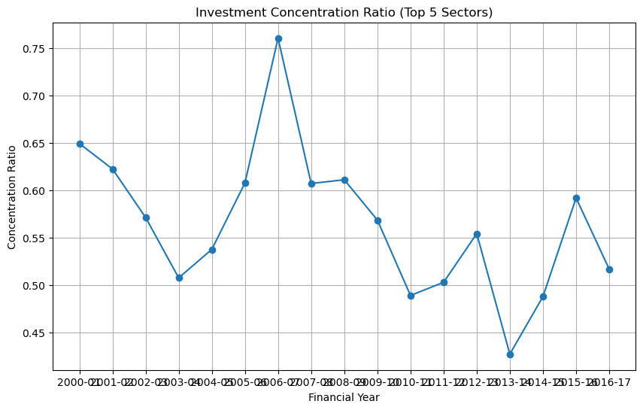
Investment Concentration Analysis How concentrated are FDI investments in a few sectors, and how has this concentration changed over time?

Slide 13
Conclusion
Investment Concentration Ratio:
- Analysis reveals fluctuations in FDI investment concentration within the top 5 sectors.
Trend Towards Diversification:
- Recent years show a trend towards decreasing concentration, indicating positive diversification.
- This trend should be encouraged through targeted policies and incentives.
Monitoring and Balanced Growth:
- Monitoring periods of high concentration is essential.
- Ensuring balanced growth across sectors will sustain a robust and diversified economic environment.
Attracting Foreign Investors:
- A robust and diversified economic environment is attractive to foreign investors.

